Slide 1
Search and the ‘Net in 2014
Michael Hunter
Reference Librarian
Hobart and William Smith Colleges
for Western New York Library Resource Council
Member Libraries’ Staff
Sponsored by the
Western New York Library Resources Council

Slide 2
For today . . .
The Searchscape
Semantic and Predictive Search
New Services and Tools
The Social Networks as Information Sources
General Web Search and Social Networks
Google: Now and more….
Free online courses
Linklist
http://people.hws.edu/hunter/searchnet14links.htm

Slide 3
The Digital World in Focus – Comscore 10/14/13 http://www.comscore.com/Insights/Presentations_and_Whitepapers/2013/The_Digital_World_in_Focus

Slide 6
Internet Audience 15+ accessing Internet from a Home or Work Desktop

Slide 7
US Search Market Share Nov. 2013 http://comscore.com
 | Nov ‘13 | annual% change
Google | 66.7 | .6
Bing | 18.1 | 1.9
Yahoo | 11.2 | -1.4

Slide 13
2013 Edelman Trust Barometer http://www.edelman.com/insights/intellectual-property/trust-2013/ College-educated individuals in upper income brackets that follow public policy issues and are active media users.
(Blogs)

Slide 14
Library Services in the Digital Age By Kathryn Zickuhr, Lee Rainie and Kristen Purcell http://libraries.pewinternet.org/2013/01/22/library-services/
26% of Americans 16+ use internet access in libraries for
research for school or work – 66%
fun or to pass the time – 63%
email – 54%
health information – 47%
visiting government websites – 41%
job opportunities – 36%
social networking sites – 35%
watching online video – 26%

Slide 15
How Teens Do Research in the Digital World by Kristen Purcell et. al. http://www.pewinternet.org/Reports/2012/Student-Research/Summary-of-Findings.aspx 2,642 AP High School teachers and National Writing Project teachers from the U.S. March-April 2012

Slide 16
Web Search in 2014 Who’s crawling the Web?
Google
Bing (aka Yahoo!)
Gigablast
Blekko
DuckDuckGo
Baidu
Yandex
Common Crawl (testing and research)

Slide 17
Not being crawled: the Deep Web in 2014
Data accessible only by a search interface
Subscription or other password-protected content
Pages with no outgoing or incoming hyperlinks
Protocols and filetypes other than
http https pdf doc xls
ppt rft kml kmz ps
dwf (autodesk) swf (shockwave flash)
DW search engine gateway:
http://oedb.org/ilibrarian/research-beyond-google/

Slide 18
Semantic and Predictive Search

Slide 19
Semantic Web Predictive Search
Web pages with added value of schema.org and other metadata
crawled by
Search engines containing
Entities and associated relationships
Anonymous query histories and search behaviors
Data about and from the searcher (location, personalization)

Slide 20
More answers, not just web pages
Increases searcher satisfaction, often depending on degree of personal information available
Discovers related information that does not contain the search term(s)
Disambiguates many terms
Colocates related information from across the Web in a variety of filetypes

Slide 21
Origins of the semantic web concept
Envisioned by Tim Berners-Lee et. al. in 2001
Common framework that allows data to be shared and reused across applications
The collection, structuring and recovery of linked data through use of common machine-readable metadata applied to web pages.
Requires consistent, universal application of controlled vocabularies
Largely unrealized

Slide 22
Yahoo Research paper - 2009 http://research.yahoo.com/files/pods09-woc.pdf
Extract structured data (addresses, prices, item #, etc.) from web documents and associate it with an entity
Link relationships between entities
An actor to his films and other actors he has worked with
Discover categorizing information in the document’s content
Subject headings
Reviews ( : or ) :
Type of food served

Slide 23
Making and searching todays' semantic web
Create informational entities consisting of text, data, images, etc. related to that concept, person, place, event, object
Link these entities in relationtionally-significant ways
Parse user queries and map to relevant entities, irrespective of text matching

Slide 24
Informational entities

Slide 25
Aemoo-Search entities for "cold war" http://wit.istc.cnr.it/aemoo Project of University of Bologna

Slide 26
Search Entities Google’s Knowledge Graph – Bing’s Satori
Created and maintained within an engine’s database and processing units
Nouns are mapped to information related and/or relevant to those nouns through n.l.p. beyond simple text matches using word frequency profiles, etc.
Results can be customized based on click responses from previous anonymous searches for that entity

Slide 27
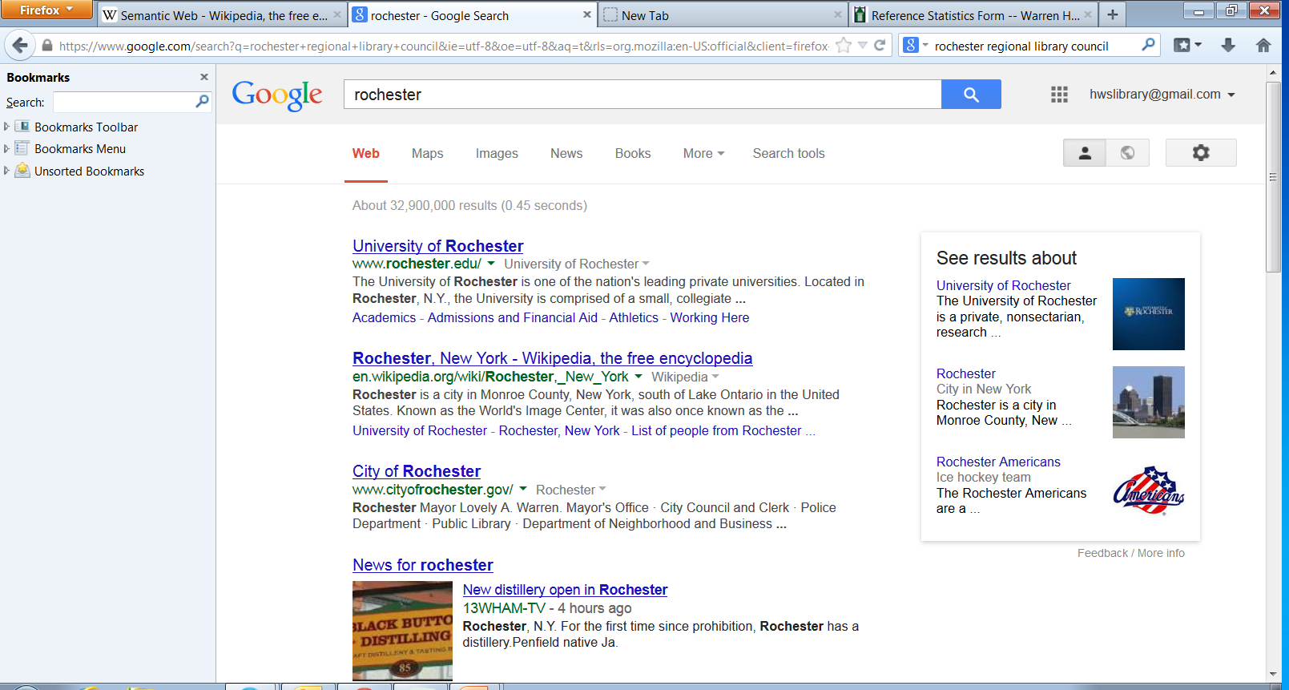

Slide 28
Relationally Significant Linkage: RDF
Based on W3C’s Resource Description Framework (RDF)
RDF extends the linking structure of the Web to use URIs to name the relationship between things as well as the two ends of the link… (allowing) structured and semi-structured data to be mixed, exposed, and shared across different applications.
http://www.seoskeptic.com/basic-vocabulary-for-schema-org-and-structured-data/

Slide 30
Meaning-full tagging: schema.org “A project to improve general Web page markup through the use of structured data”
Initiative of Google, Bing and Yahoo launched in 2011
A collection of schemas (html tags and their relationships) that webmasters can use to markup their pages in ways recognized by major search providers
Critical to developing a knowledge/answer engine producing true “meaning-full” results, not just lists of sites containing the search terms

Slide 31
Schema.org tag classes and examples

Slide 33
New Services

Slide 34
Refseek http://refseek.com
Aims to make academic information easily accessible to everyone
Over one billion documents, including web pages, books, encyclopedias, journals, and newspapers
“Documents” search retrieves pdf and other text files focused on the query topic, excluding general web results
Maintains its own subject directory
Currently in public beta

Slide 35
BASE (Bielefeld Academic Search Engine) http://www.base-search.net
Focus is academic open access information
Intellectually selected resources
Over 50 million documents from more than 2,700 sources, with 75% available in full text
Results include precise bibliographic data
Search refinement options
author, subject, DDC, year of publication, collection, language and document type
Maintained by Bielefeld University, Germany

Slide 36
etools.ch Swiss army knife of metas
Searches 15 Swiss and international engines
Results include source(s), preview, relevance rating and "status" (site data)
Clustering by topic, source engine, PDF or RSS
Language limit available (5)
Does not "log (store) your User agent, nor your IP address and uses no tracking tools, such as Google Analytics or eTracker."
Source engines receive no IP or other identifying user data

Slide 37
Common Crawl http://commoncrawl.org
Offers 5 b. web pages available to anyone free
Intended as a corpus derived from fresh, large-scale crawls for research and innovation
Successful startups using CC include TinEye and Lucky Oyster
Content from social networks limited by crawler restrictions
Access via Amazon's cloud computing service for ca. $25.

Slide 38
FindTheBest http://www.findthebest.com
"Decision Engine"
Uses structured data to calibrate "the best"
Price, ratings, social media "buzz", etc.
Sources include "public databases, manufactures websites and expert sources"
10 major categories
Allied services
FindTheData
FindTheCompany
FindTheCoupons

Slide 39
canistream.it - media metaengine http://canistream.it
Searches the 16 most popular streaming, rental and purchase services
Includes movies and television
Categories
Instant streaming Streaming rental
Digital purchase DVD/Bluray
Xfinity (cable)

Slide 40
Social Networks as Information Sources

Slide 42
Why search the social web???
Public responses/attitudes/primary sources
Breaking news, events
Trending topics and people
Latest product reviews
Companies and competition
Security, technology topics (latest virus, etc.)
Locate individuals and their networks
Who they follow, who follows them
People interested in a topic/hobby
Monitor collaborations

Slide 43
Topsy – www.topsy.com Real-time search of the social web
Results from Twitter, Vine, YouTube and other social networks
Ranking factors include
How often the page is cited in tweets
“Influence” algorithm
“Who is listening to you?”
Dynamic process assigns influence score based on
Number of followers
Their influence
How often your tweets are re-tweeted

Slide 44
Topsy – www.topsy.com Real-time search of the social web
Unlike other real time se’s, ranking is based on a deep archive of social media
Trending metrics used in ranking
What’s viral right now?
Influencers locates most influential Twitter users on topics of your choice (those with most followers)
Advanced search filters
Site/domain Twitter user
Language (10) Date, time posted

Slide 45
Tagboard
Results from Twitter, FB, Instagram, Google+, Vine and App.net
Searchable by hashtag # (single character string only)
No Boolean capabilities
Use Browser “Find” search for other terms
Tagboards- user-created collections of social media with common hashtags
Full features require an account

Slide 46
Social Media as a Primary Source: A Coming of Age Vicki Coleman 12/6/2013 Educause Review http://www.educause.edu/ero/article/social-media-primary-source-coming-age
Top 5 scholarly benefits of using social media
Keeping up-to-date with topics
Following other researchers' work
Discovering new ideas or publications
Promoting current work/research
Making new research contacts

Slide 47
Facebook's Graph Search
Entity-based, so related pages, groups are shown
When logged in relevant posts from friends are included in ranking
If no FB page has been created for the topic, a topic site is auto-generated from Wikipedia and Freebase based on FB users’ posts.
These auto-generated pages can be liked
If no FB content exists, results are pulled from Bing.

Slide 48
Homepage vs Facebook
What type(s) of information are featured in each?
Are there type(s) of information that are unique to each, and, if so, what are they?
When might an organization’s FB page be a better starting point than its homepage?

Slide 49
Why visit an organization's Facebook page?
Most up-to-date information
Historical material (archived posts)
Conversation (posts and comments)
Affiliations (likes)
Popularity
More…..

Slide 50
Today's social searchscape
Offers first-hand accounts of events and conditions
Informative of current world cultures and trends on a wide range of subjects
Gateway to blogs and other online communication that can enhance scholarship
Channel for updates to educational programs
Embedded links and other information often highly relevant and recent
Requires careful evaluation of information found there

Slide 51
Impact of the Social Web on General Web Search

Slide 52
Social Signals and Results Ranking @ Google & Bing
Social Search Verticals
Bing’s Social Search – bing.com/social
Public posts from TW, Quora and Blog sites
Login via your MS or FB account to include your own networks
Google+ - plus.google.com
Results from your G+ network; must have G+ account to access

Slide 53
Social Signals and Results Ranking @ Google & Bing
General Web search
Bing – If logged into your MS or FB account
Results from your FB friends, TW, Quora, blogs in separate listing
Google – If logged into your G account
Results from your G+ network and TW appear blended in results listing;
“Private Results” is default
setting; toggle to change

Slide 54
PageRank SocialRank What they aren’t saying…
Social Signals from FB and TW influence general web search
“Authority” of social signals
Almost all FB and TW posts are human-initiated (Fake accounts do exist)
Your “authority” depends on number of your followers/friends, their “authority” and the quality of websites you and your networks include in posts.

Slide 55
Google: Now and more….

Slide 56
Now - G's Intelligent Digital Assistant
Turns spoken natural languages queries into answers
Can be set to send you alerts
Daily specials from your favorite restaurants
Sports news, shopping discounts
Reminders
Uses search history and other data from
Your mobile devices
Google services
Other non-Google apps

Slide 57
More Now….
More contextual data available to Now returns more personalized answers
Answers are returned as virtual "cards" and audio responses "when appropriate"
Card topics currently include
Traffic Weather Sports
Stocks Flights Public Transit
Events Appointments Entertainment
Currently available on phone and tablet systems
Android 4.1, Jelly Bean

Slide 59
Entity-based search: Knowledge Graph Way beyond text matching
Understanding meaning has been the Holy Grail of web search
Knowledge graph
Purchased Freebase entities in 2009
Over 570 m. entities created containing
Over 18 b. facts associated with them
Currently includes, people, places, events and things
Entities can be associated with a person based on personal data
KG + Personal data= customized, unambiguous answers and alerts

Slide 60
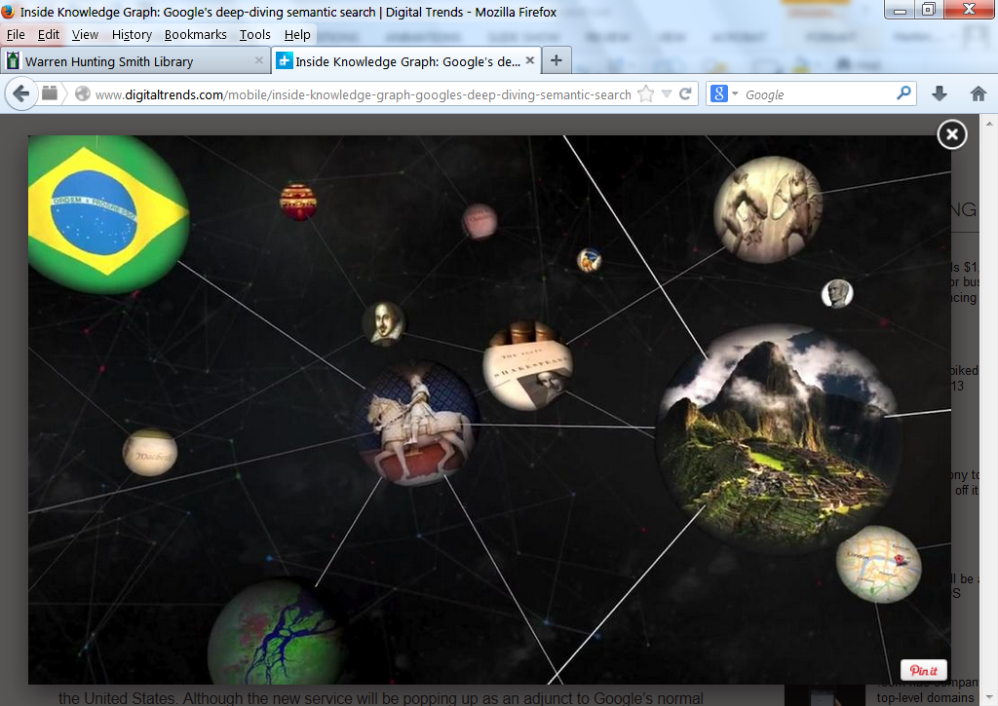

Slide 61
How terms become linked to an entity from a Google patent http://www.seobythesea.com/2013/11/google-finds-known-terms-entities/
Word frequency weighting
Term appears more often than in other similar pages (granola more often in Bakery X's homepage than in the average bakery page)
Terms that refer to the location of the entity
Terms that are variants of the entity name
Contact information associated with the entity
Terms common in documents associated with the category of the entity

Slide 63
Future challenges
Entities are now limited to the most popular topics, excludes ideas or concepts
Currently no way to map complex queries to an entity or entity group
“volcanic eruptions in the 18th century”
“Lady Gaga concerts in a warm location”
Currently limited to English only
Scalability
G receives <1 b queries daily with 16% new

Slide 64
Google Snippets
Conversational search
Speak queries, receive audio responses
Available for Google Now and via Chrome
Requires Chrome 27 or higher
Hummingbird algo update
Aims to improve results for queries involving concepts, ideas, abstractions
"acid reflux prescription"
Before - list of possible drugs
HB- includes general information on treatment with or without drugs, practitioners, diet, etc.

Slide 65
In-Depth Articles
For broad topics and themes
First 3 appear at bottom of results page
"…the best in-depth articles from across the web"
Top sources on 9/14/13
25% nytimes.com 4.2% wired.com
8% wsj.com 3.9% slate.com
5.7% new yorker.com 2.8% forbes.com
5.6% theatlantic.com 2.7% nymag.com
Social networks may influence selection

Slide 66
APA, AG Lawsuits settled
2005 – Association of American Publishers and McGraw-Hill, Person, Penguin, John Wiley, Simon & Shuster allege copyright violation in the Library scanning project
2012- Google settles with publishers, who may now remove their books or journals from the Library project
2013 - Author’s Guild suit settled Nov. 14
Book scans are "fair use" (AG will appeal)

Slide 67
Free online courses and more…
Open Education Database http://oedb.org
Over 10,000 free courses
Formats include video lectures, audio lectures, text articles and mixed media
Arts Business Education Math
Engineering and Computers Liberal Arts
Medicine Sciences
Online Courses Gateway at Lifehacker.com
12 sources for credit and non-credit courses
Annotated listing

Slide 68
Future of Search: the knowledge engine
Technical challenges
Understanding context and meaning from a wide range of text, data and images
Parsing natural language text and queries, particularly brief ones on mobile devices
Presenting results in a comprehensible and meaning-significant form
Web-scale processing of all the above
Business challenges
Consistent and reliable partnering with knowledge providers

Slide 69
Thank You and Enjoy Your Searching!
Michael Hunter
Reference Librarian
Hobart and William Smith Colleges
Geneva, NY 14456
(315) 781-3014 hunter@hws.edu

